Slide 1



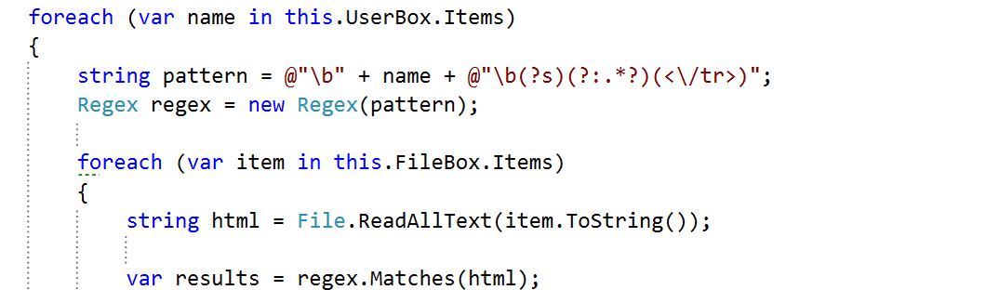
C# Advanced
Course Introduction
C#
SoftUni Team
Technical Trainers
Software University
http://softuni.bg

Slide 2







SoftUni Diamond Partners

Slide 3
Questions
sli.do #CSharp-Advanced

Slide 4
C# Web Profession
C# Fundamentals Module
C# Advanced Course
Fully supported by Microsoft
~500 Offers @ Jobs.BG
Scope
Trainers
Evaluation

Slide 5
C# Web Profession
C# Fundamentals Module
C# Advanced Course
Algorithmic and Conceptual Courses
Prelude to Database and Web Technology Courses
Scope
Trainers
Evaluation

Slide 6
C# Web Profession
Standard .NET API
C# Fundamentals Module
Algorithmic thinking
C# Advanced Course
Scope
Trainers
Evaluation

Slide 7


C# Advanced Course
Scope
Trainers
Evaluation

Slide 8
Trainers
Ventsislav Ivanov
Technical Trainer @ Software University
Certified QA
Knowedge at web testing
Experience as QA automation engineer

Slide 9
Trainers
Valentin Dimitrov
Technical trainer @ Software University
Top performing student from the Software University
Over two years experience in software developing

Slide 10
Trainers
C# Advanced Course
Scope
Evaluation

Slide 11
Examination
Activities
Bonuses
Forum Activity
Nested Linear Structures
Attendance
Algorithmic Problem
C# Advanced Course
80%
25%
20%
Nested Data Structures
Team Work
15%
String Processing
5%
Scope
Trainers
Evaluation
Exercises
Labs

Slide 12
C# Web Profession
C# Fundamentals Module
C# Advanced Course
Scope
Trainers
Evaluation

Slide 13


Your RFID Chip
Students can either
Take RFID chip from SoftUni
Or use their own chip / card
Register your chip number in your SoftUni profile: https://softuni.bg/users/profile/show
Check-in at the reception every time when you come
See your last visits in your profile: https://softuni.bg/users/profile/show

Slide 14









Resources
What We Need Additionally?

Slide 15

Course Web Site & Forums
The C# Advanced official web page:
Register for the "Software University Forum":
Discuss the course exercises with your colleagues
Find solutions for all course exercises
Share source code / discuss ideas / help each other
https://softuni.bg/courses/advanced-csharp
http://softuni.bg/forum

Slide 16



The C# Advanced Slides and Videos
All lecture slides, videos, exercises, projects and other resources are open content, available for free
Visit the course web site to access the course resources

Slide 17

The Free C# Fundamentals Textbook
The official textbook for the course
"Fundamentals of Computer Programming with C#", by Svetlin Nakov & Co., 2013, ISBN 9789544007737
English and Bulgarian versions (as PDF, ePub, …)
Freely downloadable from: www.introprogramming.info
The C# Programming courses @ SoftUni.bg partially follows the book

Slide 18


Required Software
Software needed for this course:
Microsoft Windows (Win 10 / 8.1 / Win8 / Win7)
Visual Studio Community 2017 (a free version of VS 2017)
Visual Studio 2015, 2013, 2012 acceptable, but not recommended
.NET Framework 4.6 (included in Visual Studio)

Slide 19




C# Advanced– Course Intro
https://softuni.bg/courses/advanced-csharp

Slide 20
License
This course (slides, examples, demos, videos, homework, etc.) is licensed under the "Creative Commons Attribution-NonCommercial-ShareAlike 4.0 International" license
Attribution: this work may contain portions from
"Fundamentals of Computer Programming with C#" book by Svetlin Nakov & Co. under CC-BY-SA license

Slide 21






Free Trainings @ Software University
Software University Foundation – softuni.org
Software University – High-Quality Education, Profession and Job for Software Developers
softuni.bg
Software University @ Facebook
facebook.com/SoftwareUniversity
Software University @ YouTube
youtube.com/SoftwareUniversity
Software University Forums – forum.softuni.bg

